Slide 1
Rights of these slides are reserved to PF Team as mentioned in the lecture by Dr. Awais ☺

Slide 2


Files and Exceptions
Week 14

Slide 3


Why do we need files?
Why do we need files?
Notes:
When we do some processing on the data we need to save the useful or required results permanently so we use file handling

Slide 4
Why do we need files?
We need the files to make our data persistent

Slide 5

Persistent Data VS Non-persistent Data
Data we store in variables is called non-persistent data.
Non-persistent mean when we close the application or program ends the data stored in the RAM is removed by Operating System
a = 10
b = 20
sum = a + b
print(sum)
Notes:
Give some example of operating system here to make them clear what exactly operating system is.

Slide 6

Persistent Data VS Non-Persistent Data
Data we store in file is called persistent data.
Persistent mean when we close the application or program ends the data would not remove.
Like you save an assignment file on your computer and you can view or edit the file anytime even after weeks or months.
This storage is also called permanent

Slide 7
Class Activity
List down the files you saved in last week or in last two weeks?
Now Remember which software you used to save those files?

Slide 8

What we have done so far?
We wrote many programs to solve different problems.
But the data was not persistent.
In Real world applications we need to store the data into files.
Every programming language provide the facility to work with files.

Slide 9
Start File Handling with Python
< Let’s go with some python code />

Slide 10
Opening File in Python
Syntax:
variable = open(“file path”)
f = open("test.txt") # open file in current directory
f = open("C:/Python38/README.txt") # specifying full path

Slide 11
Opening File Modes
Mode | Description
r | Opens a file for reading. (default)
w | Opens a file for writing. Creates a new file if it does not exist or truncates the file if it exists.
x | Opens a file for exclusive creation. If the file already exists, the operation fails.
a | Opens a file for appending at the end of the file without truncating it. Creates a new file if it does not exist.
+ | Opens a file for updating (reading and writing)
b | Opens in binary mode.
Notes:
Modes mean in which mode you want to open the file for the reading purpose or writing purpose.

Slide 12
Opening File Modes Example
f = open("test.txt") #default mode r
f = open("test.txt",'w') # write in text mode
f = open("img.bmp",'r+b') # read and write in binary mode
Notes:
Reading the file

Slide 13
An Example to Write your name in file
f = open("test.txt“, “w”)
f.write(“This is my name”)
f.close()
Notes:
It is good to close the file but python do close it automatically with help of its garbage collector.

Slide 14
An Example to Read your name in file
f = open("test.txt“, “r”)
data = f.read()
print(data)
f.close()
Notes:
It is good to close the file but python do close it automatically with help of its garbage collector.

Slide 15
An Example to append the data in file
f = open("test.txt“, “a”)
f.write(“ I am new data with existing data”)
f.close()
Notes:
It is good to close the file but python do close it automatically with help of its garbage collector.

Slide 16
readlines() function in file handling
f = open("test.txt")
data = f.readlines()
print(data[0:4])
f.close()
This will read the line 0 to 4 and print it.
Notes:
Read line function read the file in lines in the list and you can use list functions to use the read data
Like the range function would display the given line numbers or line between the given range.

Slide 17
Delete the file
import os
os.remove(“filename.txt”)
Notes:
Import os will import operating system python library and we can use that os library to perform operating system functions like deleting the file etc

Slide 18
Checking if file exists?
import os if os.path.exists("demofile.txt"): os.remove("demofile.txt") else: print("The file does not exist")
Notes:
This is safer code. It will check first the file exist or not. If file exist it would delete the file otherwise it would display file does not exist.

Slide 19
Working with CSV
What is CSV ???
CVS is just like other files but it store the data in some defined format

Slide 20
Working with CSV
How it store the data?
CSV file store comma separated data in it.

Slide 21
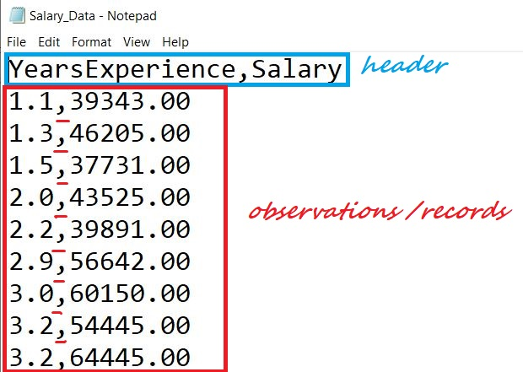
Example of CVS file data
Notes:
Here you can see the labs the first row is header of the data and other rows are the datas

Slide 22

Reading data from csv file with Pandas
You can perform many operations on csv file with help of Pandas library
Notes:
Pandas is python library that provide you many features to perform different operations on the data

Slide 23
Reading data from csv file
import pandas as pd
data = pd.read_csv('Salary_Data.csv')
Notes:
Read the csv file with pandas library

Slide 24
Reading data from csv file
import pandas as pd
data = pd.read_csv('Salary_Data.csv')
print(data.columns)
Notes:
This line would print the columns of csv file

Slide 25
Reading data from csv file
import pandas as pd
data = pd.read_csv('Salary_Data.csv')
print(data.salary)
Notes:
This highlighted line will print the all the salaries in the csv file only

Slide 26

Learning Objective
In this lecture, we learnt how to write, read, append data in file, delete file and work with CSV files
Notes:
After this lecture, you shall be able to Explain why we need variables and what is their relation to the memory.

Slide 27

Conclusion
To make data persistent
To perform Create, Read, Update and Delete operation on files.
Notes:
Programming main decision making achieve kerny k leay conditional structure use hoty hain, comparision operator jisy ham double equal operator bhe bolyt hian 2 values ko compare kerny k leay use hota hia.
Is k elawa if command main likhe jany wali condition ko ham Boolean expression bhe khety hain.

Slide 28

Self Assessment
Solve Following Programs
Find or Create a CSV file with 100 students marks and find the max, min and average marks from that csv file.

Slide 29
Self Assessment
Solve Following Programs
F

